Slide 1

MINOR PROJECT – IIl ON FLAPPY BIRD (MCA – III SEMESTER; BATCH 2021-23)
Internal Guide
Dr. Sunil Pratap Singh
(Asst. Prof., BVICAM, New Delhi)
Presentation by
RITIKA KUMARI (00635304421)
Date of Presentation :- 28/01/23
Notes:
1

Slide 2
Contents
Problem Description
Aim and Objectives
Methodology and Technology Used for Project Development
Roles in the project
Working Principle
Libraries and Functions
Algorithm
Design Documents (Flow Chart & Use Case Diagram)
Screenshots
Conclusion
Future Scope
Bibliography

Slide 3
Problem Description
Flappy Bird is an arcade game where you control a likeable bird that has to fly through many obstacles all made up of pipes.
The mechanics are very simple: you have to tap the screen so that the bird flaps its wings, trying to keep a steady rhythm in order to pass through the pipes scattered through its path. It won't be at all easy to do.
It was released in May 2013 but got sudden rise in popularity in 2014.
It was designed for iOS at first but was adapted as android game also due to rise in popularity.

Slide 4
Aim and Objectives
Aim:
To develop a game using PyGame module.
Objectives:
To design ease & user-friendly interfaces to interact with the system.
To apply Computer Graphics to get familiar with drawing pixels, image processing, etc.
To re-create the popular arcade game “Flappy Bird” using pygame module.

Slide 5
Methodology and Technology Used
Technology used for Project Development:
Python 3.0
Integrated Development Environment (IDE): PyCharm IDE

Slide 6
Roles in the Project
1) Ritika Kumari – I have done the designing part ie; all the images and graphics that are attached in this project are designed and collected by me and I have written the two function (welcomeGame() and endGame()) and implement their workings in game .
2) Saurav Gupta - I have collected the sounds required for this project and written remaining of the source code and implement all of the workings with synchronization of all function , sound effects and graphics.

Slide 7
Working Principle
Flappy Bird is a side-scroller game meaning that it works on left to right order.
The player controls the bird by pressing space bar.
Random height vertical pipes are generated from top and bottom of the screen with little gap in between.
The player needs to control the bird such that it won’t collide with the vertical pipes.
The bird falls at a given acceleration if space bar is not pressed.

Slide 8
Libraries Used :
Pygame
Random
sys

Slide 9
Functions() and My Role
Project Functions:
welcomeScreen()
mainGame()
getRandomPipe()
IsCollide()
EndGame()

Slide 10
Algorithm:
Step 1: Start
Step 2: Run the main Loop
Step 3: Run the game
If loaded:
Draw Bird
Draw Background
Draw Pipes

Slide 11
Contd….
Step 4: While running:
If Collision Detected:
Go to Step 5
Else:
Go to Step 3
Display Score
If resumed:
Go to step 3
Step 5: EXIT

Slide 12
System Design

Slide 13
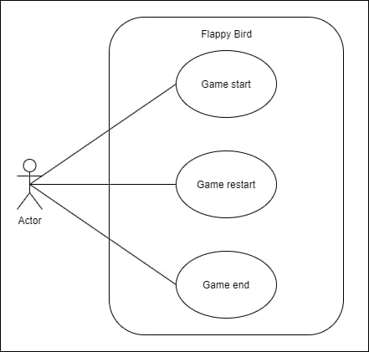
Use Case Diagram

Slide 14
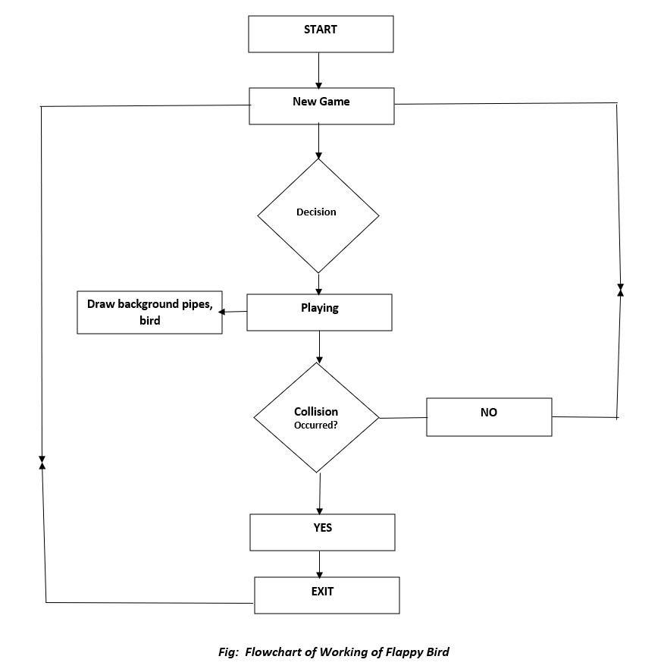
Flow Chart

Slide 15
Screenshots

Slide 16
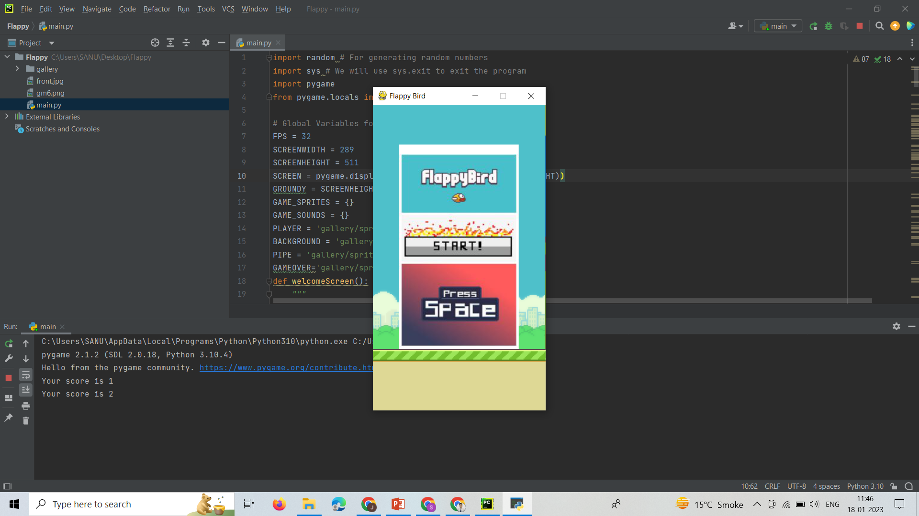
Screenshot - 1: welcomeScreen()

Slide 17
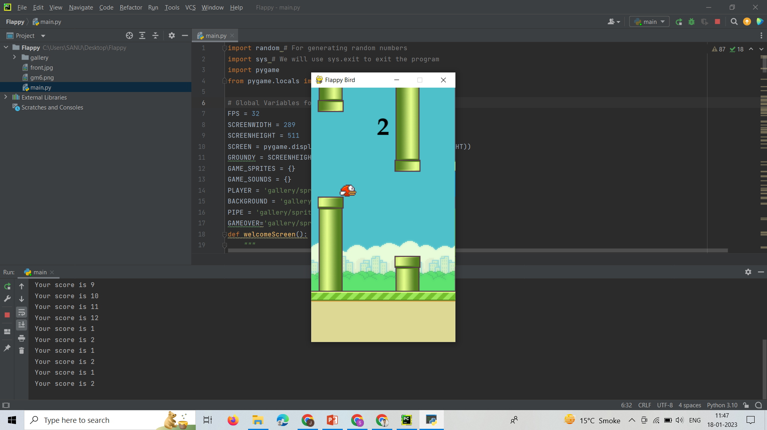
Screenshot - 2: Pipes and Background

Slide 18
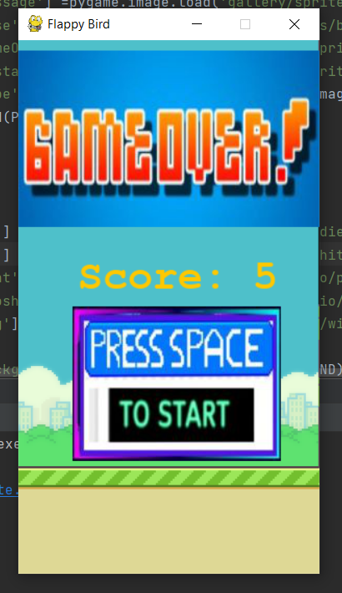
Screenshot – 3: endgame()

Slide 19
Conclusion
Flappy Bird can be created using any programming language. We chose the Python language, pygame module because it is easy to use and is easy to implement game logic in pygame.
Our project is 2D game, as pygame is specifically made for 2D games it was easy for us to create flappy bird with its user-friendly modules and methods.

Slide 20
Future Scope
The current version of our project is offline, we are planning to make it online.
We are planning to add the global leader boards functionality so that players can compete online.
To add new functionalities like : Pause and Resume

Slide 21
Bibliography
https://pygame.org/
Learning pygame by making flappybird – Clear Code
https://www.youtube.com/watch?v=UZg49z76cLw&t=1215 s
Tech with Tim – Pygame programming tutorials
https://www.youtube.com/watch?v=i6xMBig-pP4&list=PLz McBGfZo4-lp3jAExUCewBfMx3UZFkh5
Code with Harry - Pygame programming tutorials
https://youtu.be/itB6VsP5UnA

